Slide 1

TOK PRESENTATION
BY ELINA KHER

Slide 2
An Overview of the lives of people who demand basic human rights

Slide 3

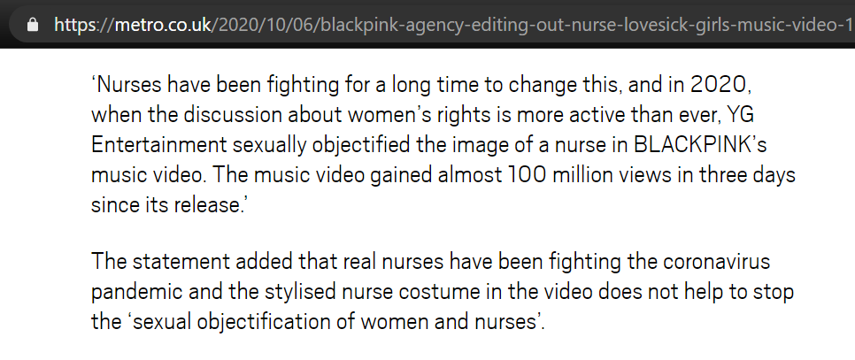
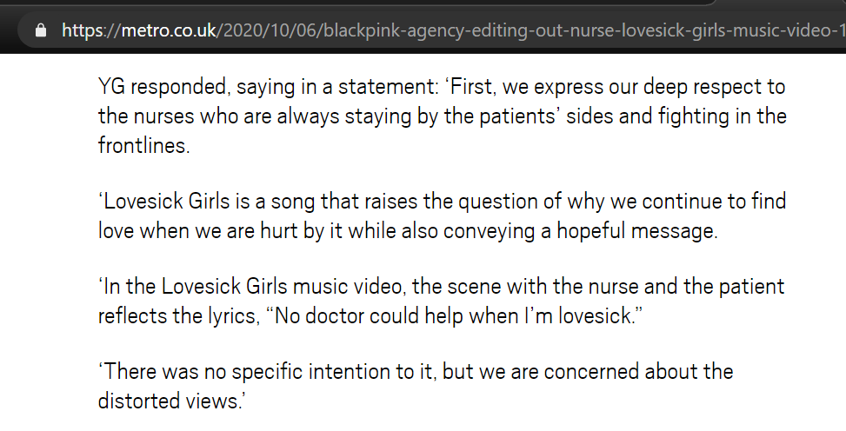
Real Life Situation
Scenes of Blackpink’s Jennie dressed as a sexy nurse removed from their music video of Lovesick Girls
In the recent title track of a famous girl kpop group, blackpink there were scenes of a member dressed as a nurse; wearing a cap with a heart symbol, a tight short skirt and high heels. Which depicted the symbolized stereotypical image of a sexualized nurse.
The scenes got removed because it triggered and offended healthcare workers as YG Entertainment being one of the big 3 entertainment companies in the k-pop industry, displayed such a depiction which was in favour of objectification of nurses.

Slide 4
Central Knowledge Question
To what extent does culture affect our understanding and acceptance of knowledge?

Slide 5
WOK’s
Sense Perception
Reason
AOK’s
The Arts
Human Sciences
WOK’S
AND
AOK’S

Slide 6
Link between the RLS and CKQ
Kpop music videos usually sexualize and objectify women alot. implementing it in its culture
Jennie one of the most famous idols wearing such an outfit lead to promotion of such ideologies
Arts/ Humans sciences
Jennie wearing an outfit that objectified nurses in a sexual manner
YG entertainment removing those scenes of jennie where she’s dressed as a nurse
Sense perception
The healthcare community objecting against such a display of a whole profession even if that profession does not indulge in such activities in the first place
Reason

Slide 7
RKQ 1
To what extent does culture influence one’s perception of liberty?

Slide 8
Claim
Culture and traditions may impede the free will of individuals.

Slide 9
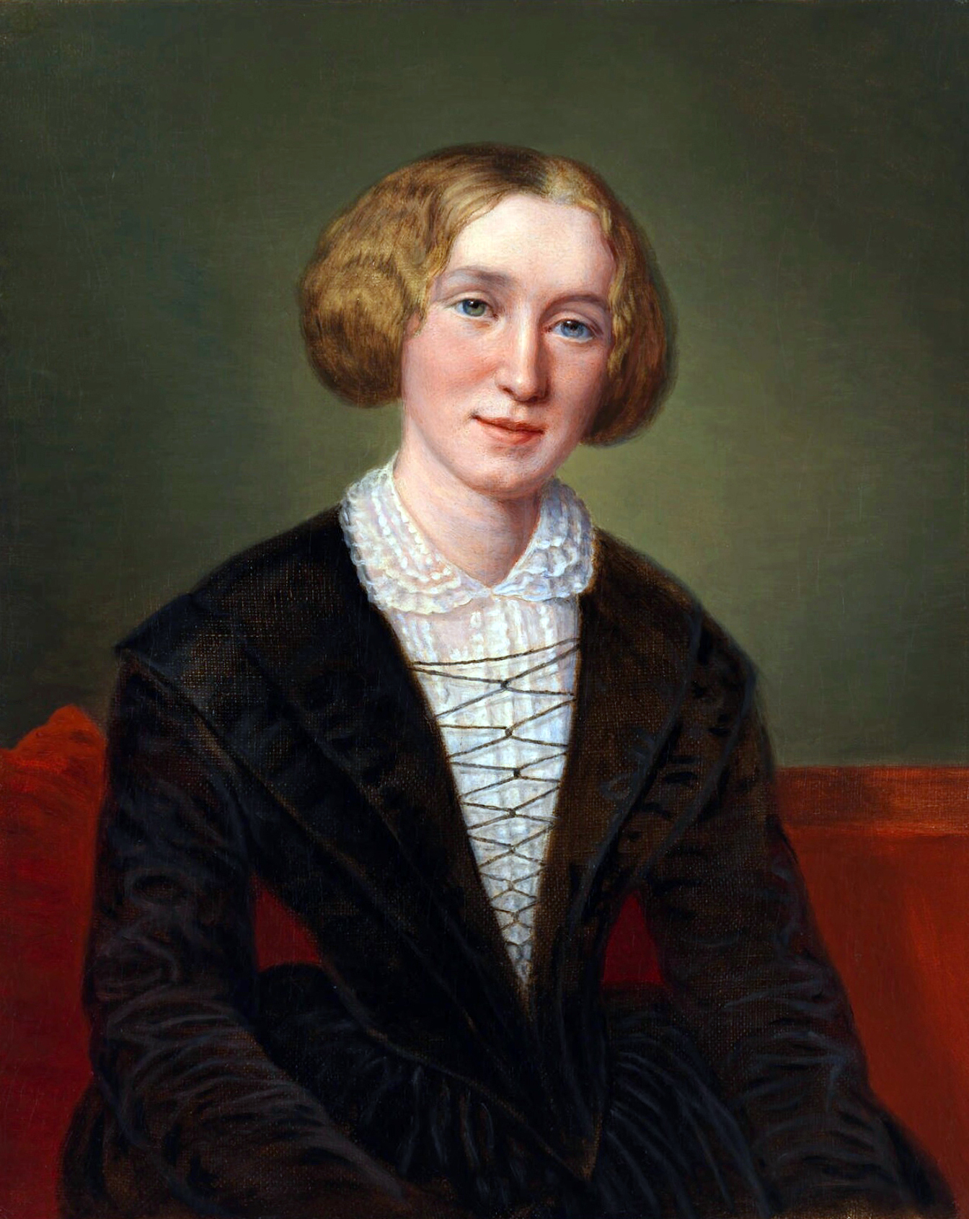
George Eliot
George Eliot was a english writer, novelist, journalist, poet and translator in the victorian era. She has written many award winning novel like Adam Bade, the mill on the floss, felix holt and many more.
George Eliot at the start of her career was forced to adapt a male pen male pen name otherwise she would not have been allowed and able to publish even one book.
Her real name is Mary Ann Evans.

Slide 10
Counterclaim
Reasoning in particular subjects helps changing in perception of individuals to lift and reduce such norms

Slide 11

India’s prime minister plogging near his ressort
India’s prime minister Mr. Narendra Modi was found plogging near his ressort where he hosted an informal summit talkies with china’s president Xi Jinping.
The activity of plogging consists of picking out litter nearby while on you daily jog. Which is good for your health and also the environment.
Ever since this event originated in sweden many countries have started promoting this practise because of its environmental and health benefits

Slide 12
Paralel RLS
Passenger Profiling Discrimination
Muhammad Khairullah landed on JFK airport on 2nd augest 2019, and founf himslef detained with US customs and border protection officers. Khairullah fled from syria and was returning from a family holiday to turkey. Yet the border patrol agents were suspicious that he endulged in terroristic activies just because he was from syria and was a muslim. He was eventually realised after 2 hours, although his phone was retained by authorities for a further 2 weeks
“ A few bad apples don't spoil the bunch”

Slide 13
Subsidiary knowledge question 2
To what extent do our existing personal knowledge and our perspective impact assimilation of new knowledge?

Slide 14
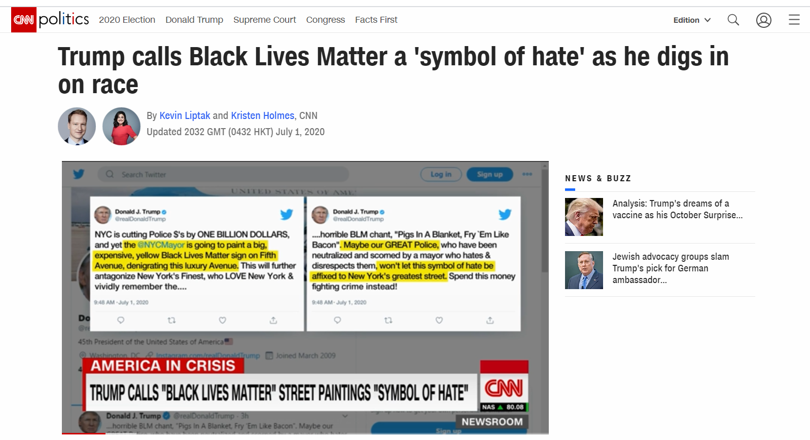
Claim 2
Authority can lead to Biased decision making of crucial elements
Black Lives Matter
The US president, Donald Trump commanded Federal law enforcements at protests in Oregon's largest city against the black lives matter protesters. The Witnesses say that federal agents in unmarked Vans grabbed protestors off the streets and detained the residents without cause.
Mr. Trump has known for being racist towards black people has tends to have a bais midst he protest

Slide 15
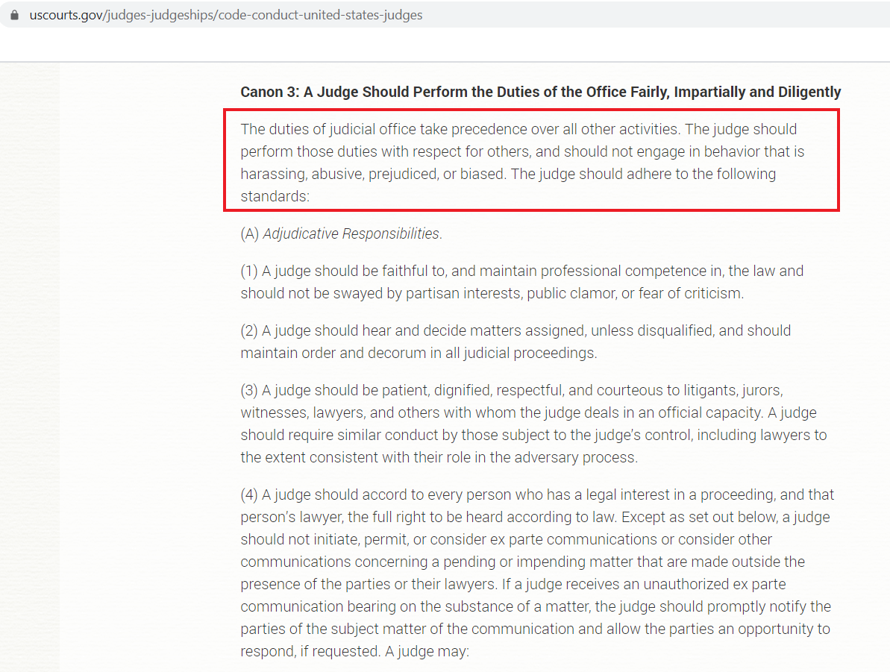
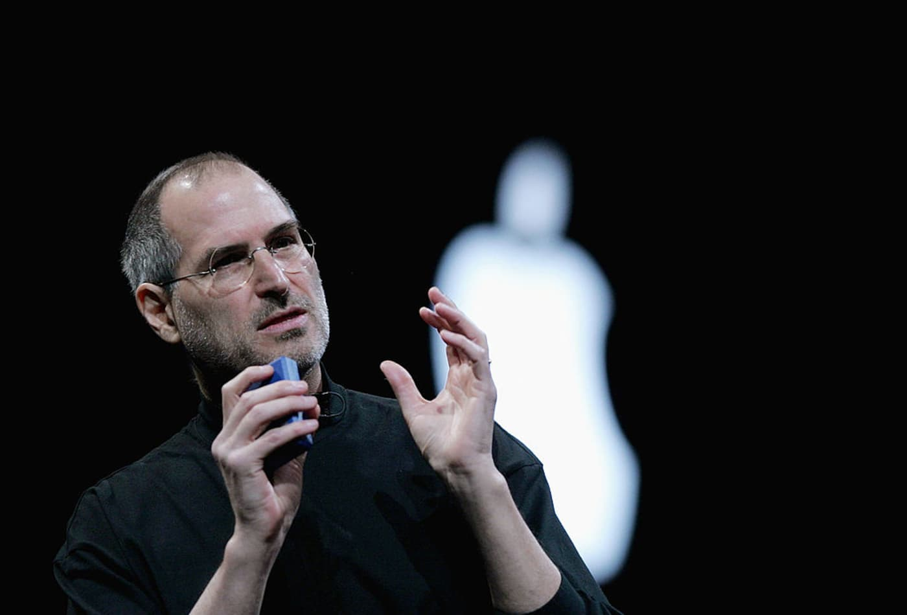
Counterclaim 2
Sense Perception and Intuition can result in making ethical decisions

Slide 16
Conclusion
Stereotypes/cultures/traditions may lead to individuals having a bias in situational biases
Deductive reasoning, sense perception and intuition may allow individuals to make ethical decisions against their biases
Biases in these situation have been unhealthy, but i feel that we should nurture them but only to a point wherein they don't intervene with our decision making, as i feel our biases form up our unique personalities.

Slide 17
Bibliography
https://cnalifestyle.channelnewsasia.com/trending/blackpink-jennie-sexy-nurse-outfit-lovesick-girls-music-video-13227266
https://www.shethepeople.tv/home-top-video/sexual-dolls-female-kpop-industry-sexualises-singers/
h
https://edition.cnn.com/2020/07/01/politics/donald-trump-black-lives-matter-confederate-race/index.html
https://www.aljazeera.com/news/2020/07/growing-criticism-trump-abuse-power-portland-200721122558564.html
https://www.cnbc.com/2017/08/29/steve-jobs-and-bill-gates-what-happened-when-microsoft-saved-apple.html#:~:text=When%20Jobs%20announced%20the%20%24150,also%20a%20new%20business%20opportunity.
https://theculturetrip.com/middle-east/articles/the-islamic-new-year-what-is-muharram/
httphttps://indianexpress.com/article/what-is/explained-what-is-plogging-6065464/s://www.airport-technology.com/features/airport-passenger-profiling/

Slide 18
THANK YOU

